Slide 1

Retail Sales Analytics
An End-to-End Data Analytics Project
Presented by Dinesh S

Slide 2

Project Overview
Objective: To derive business insights from retail sales, customer and inventory data.
Key Focus Areas:
Analyze sales trends and product performance
Understand customer behavior
Track inventory levels
Create a dynamic Power BI dashboard
Tools Used: Excel, SQL, Python, Power BI

Slide 3

Problem Statement
Retail companies often struggle to:
Track real-time sales performance
Identify top-performing products
Understand customer purchasing patterns
Monitor inventory efficiently
This project aims to solve these challenges using data analytics.
Project Goals
Identify high-performing stores, products and staff
Segment customers based on behavior (e.g., RFM)
Monitor inventory and highlight low-stock products
Build interactive dashboards for better business decisions

Slide 4

Dataset Overview
Data Source: Sales & Production database (ER Diagram included)
Tables Used: customers, orders, products, stores, staff, order_items, stocks, etc.
Data Points:
Customer: ID, name, contact
Orders: date, status, staff, store
Products: price, category, brand
Inventory: quantity, store, stock level

Slide 5
Excel – Data Cleaning & Preparation
Standardize Column Headers
Imported all raw files into Excel using Get Data from Folder.
Verified all column headers use snake_case for consistency.
Remove Duplicates
I have used the remove duplicates function to eliminate duplicate records from the table.
Handle Missing Values
I used the filter option to check for any null or blank values in the table. If missing values were found, I used the Ctrl + F (Find and Replace) feature to replace them with appropriate placeholders like ‘-’.
Data Type Conversion
"I formatted the order_date, shipped_date and required_date columns using Excel’s Date format. I also formatted the quantity, list_price, discount and total_price columns using Number format through the Format Cells option."

Slide 6
Data Validation
I replaced the values 3 and 4 in the order_status column with "Pending" and "Delivered".
Then, I selected the entire column and used Data Validation to create a drop-down list with order statuses.
This helps to:
Maintain consistency in values
Avoid typing mistakes during data entry
New Derived Columns
Created a new column total_price in order_items using the formula: (list_price × quantity) – discount
Calculated actual revenue per item for all rows using Excel formula
Merge Lookup Data
Used =VLOOKUP(C2, products!A:B, 2, FALSE) to retrieve product_name from the products sheet into order_items.
Placed product_name in column D and total_price in column H.

Slide 7
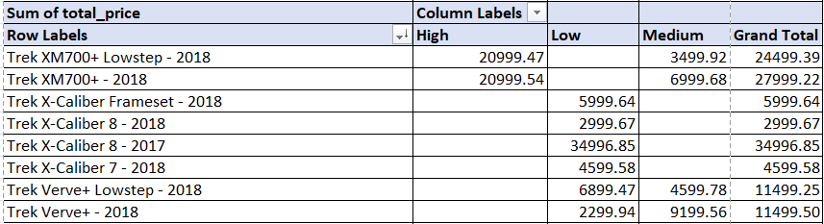
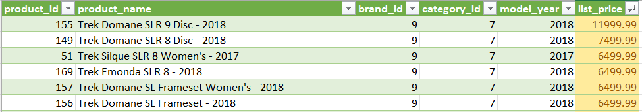
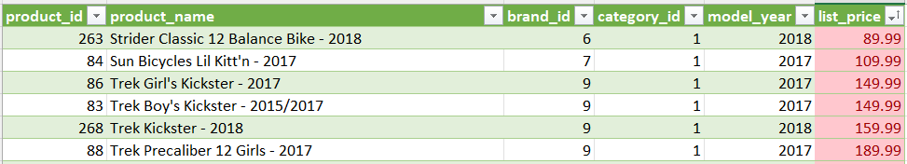
Basic Pivot Table
Created a new column price_range using an IF formula to classify total_price as Low, Medium or High.
Built a Pivot Table with product_name in Rows, price_range in Columns and Sum of total_price in Values.
This helped analyze product-wise revenue distribution across different price segments.
Sort and Filter for Outliers
Selected the list_price column from the products table.
Applied Conditional Formatting → Top/Bottom Rules → Top 10% to identify high-priced products.
Applied Conditional Formatting → Top/Bottom Rules → Bottom 10% to identify low-priced products.
Highlighted these values to visually spot the outlier products in both high and low price ranges.

Slide 8

SQL – Database Management and Querying

Slide 9
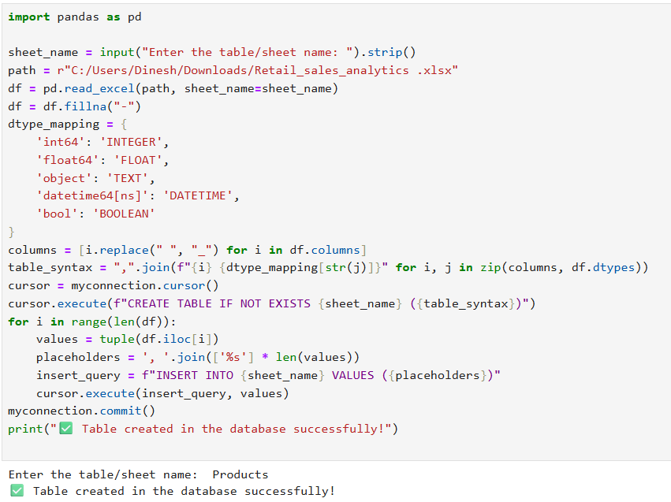
Python for Data Migration:
Used Python to automate the data migration from Excel to MySQL, instead of doing it manually.
Benefits of Python for Data Migration:
Time-Saving:
Automates and speeds up the process.
Error Reduction:
Minimizes human errors during import.
Consistency:
Ensures uniformity in data processing.
Scalability:
Handles large datasets more easily.
Flexibility:
Reusable scripts for future data migrations.

Slide 10
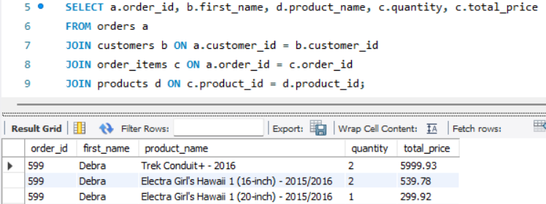
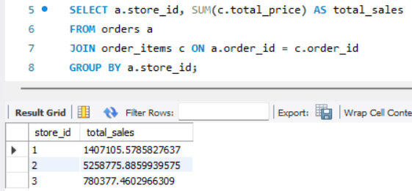
Inner Join for Order Details
Task: Joined orders, customers, order items, and products to fetch detailed order information. Benefit: Enables detailed sales reporting, helping to understand customer preferences and product performance.
Total Sales by Store
Task: Calculated total sales for each store. Benefit: Provides store-wise sales data, enabling performance comparison and highlighting areas that need improvement.

Slide 11
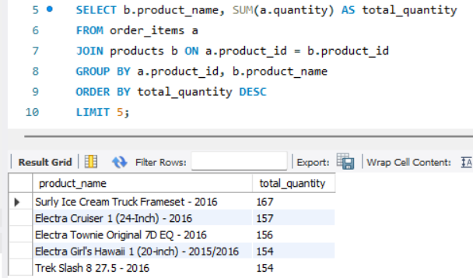
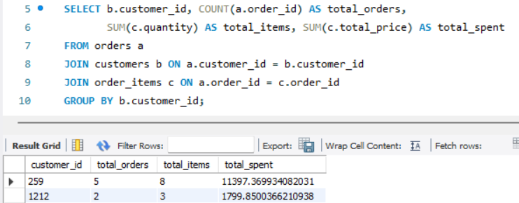
Top 5 Selling Products
Task: Retrieved the top 5 best-selling products by quantity. Benefit: Focuses inventory and marketing efforts on high-demand products, ensuring they remain well-stocked.
Customer Purchase Summary
Task: Calculated total orders, items purchased, and total spend per customer. Benefit: Helps in building customer profiles and facilitates segmentation for targeted campaigns.

Slide 12
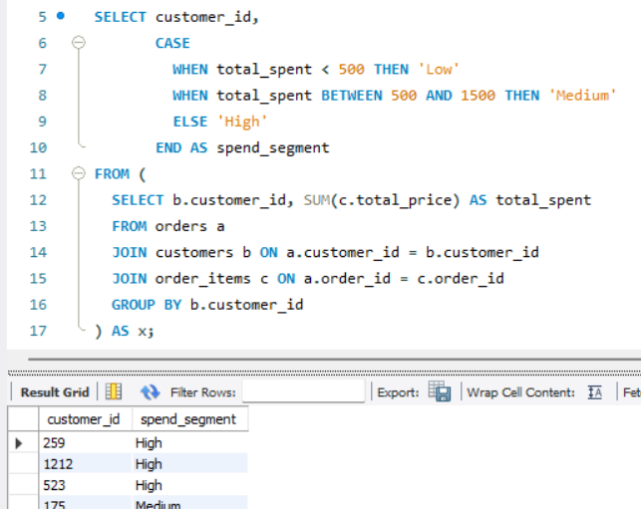
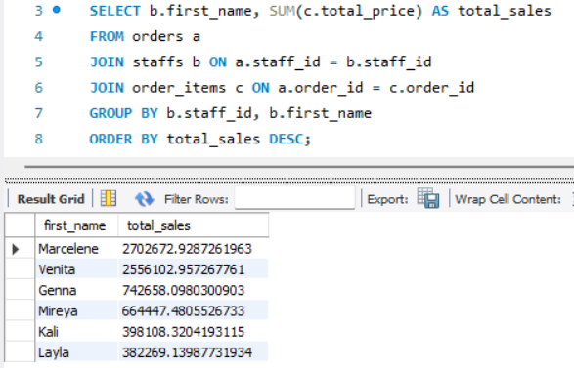
Customer Spend Segmentation
Task: Segmented customers based on their total spend into low, medium, and high categories. Benefit: Improves marketing efforts by enabling targeted campaigns tailored to customer spend behavior.
Staff Performance Analysis
Task: Analyzed total sales per staff member. Benefit: Identifies top-performing staff which helps in rewarding high performers or providing training to underperformers.

Slide 13
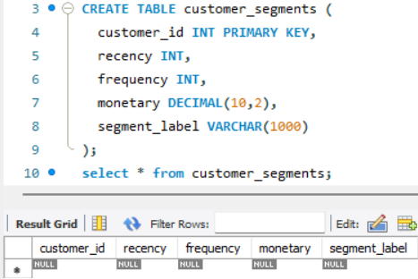
Low Stock Alert
Task: Identified products that have low stock levels in the inventory. Benefit: Allows timely restocking decisions to prevent stockouts and meet customer demand.
Create Customer Segments Table
Task: Created a table to store customer segmentation details based on recency, frequency, and monetary (RFM) analysis. Benefit: Facilitates customer segmentation and the use of machine learning models for better decision-making in marketing strategies.

Slide 14

Python is a simple and powerful programming language used for websites, data analysis, automation, and more.

Slide 15
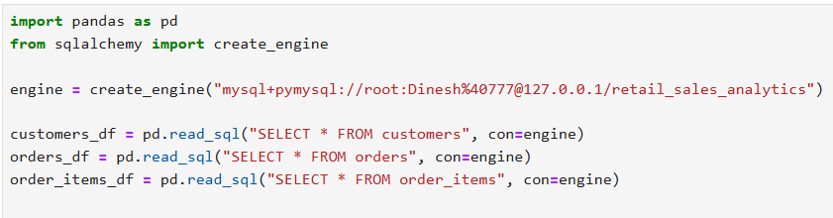
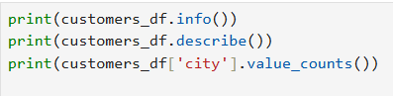
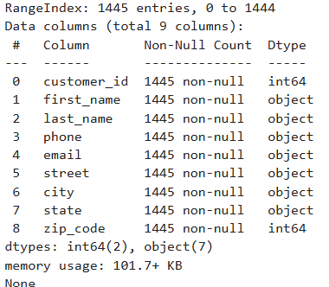
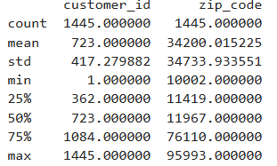
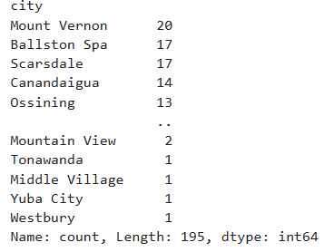
Load Data from SQL using Python
Established a connection between Python and the MySQL database using SQLAlchemy.
Retrieved data from the customers, orders, and order_items tables using pandas.read_sql().
Stored the extracted data in Pandas DataFrames for further analysis and modeling.

Slide 16

Benefits of Basic EDA
Data Understanding: Helps quickly understand structure and content of the dataset (columns, datatypes, missing values).
Summary Statistics: Gives insights into numerical data ranges, outliers and distributions.
Data Quality Check: Detects missing values or incorrect data types early.
City Distribution Insight: Identifies top and bottom locations by customer count — useful for geographic targeting.
Informs Further Analysis: Sets the stage for deeper analysis and visualization.

Slide 17
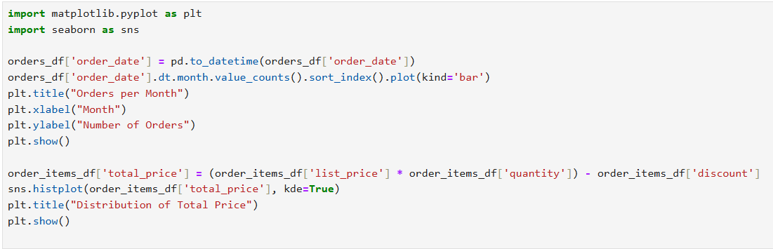
Orders per Month (Bar Chart)
Converted order_date to datetime format
Extracted month and counted number of orders
Plotted monthly order counts using a bar chart
Total Price Distribution (Histogram)
Calculated total_price = list_price × quantity − discount
Plotted distribution of total prices using seaborn.histplot with KDE curve
Visualizing Data using Python

Slide 18
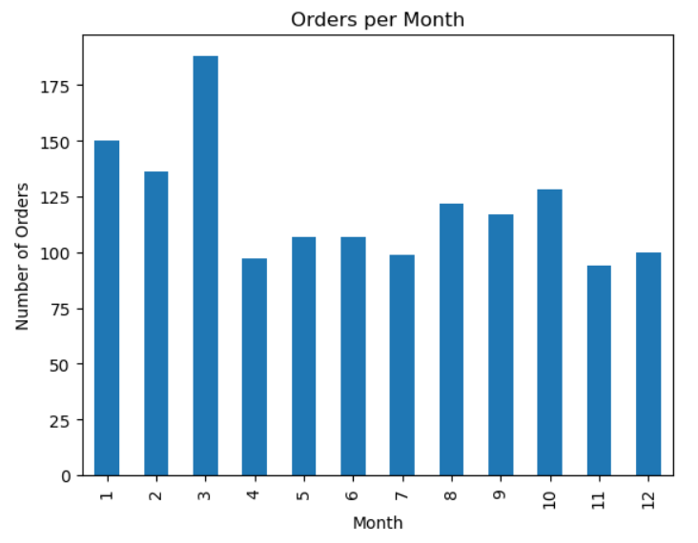

Slide 19
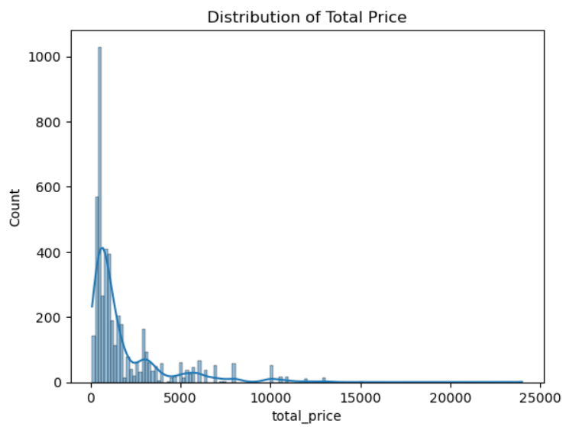

Slide 20
Benefits of Data Visualization
Trend Discovery: Bar chart reveals peak and low months for orders, useful for seasonality insights.
Revenue Insight: Histogram shows how total prices are distributed, helping identify pricing patterns or outliers.
Decision Support: Visualizations make it easier to communicate findings to stakeholders.
Next Steps Ready: These plots guide what to explore next—like high-value transactions or off-season sales.

Slide 21
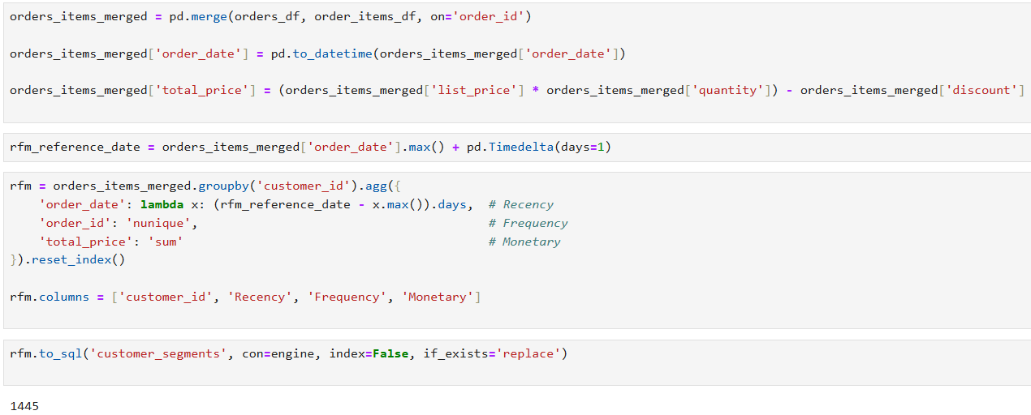

Slide 22
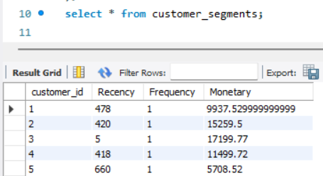
Customer Segmentation Using RFM Analysis
Loaded orders, order_items tables
Merged datasets using order_id
Calculated total_price = (list_price × quantity) - discount
Set reference date as 1 day after the latest order
Computed:
Recency: Days since last purchase
Frequency: Number of orders
Monetary: Total value of purchases
Stored the results in a new SQL table: customer_segments
Benefits
Identifies high-value vs inactive customers
Helps in creating targeted marketing campaigns
Drives retention strategies for loyal customers
Enables data-driven segmentation for better personalization

Slide 23
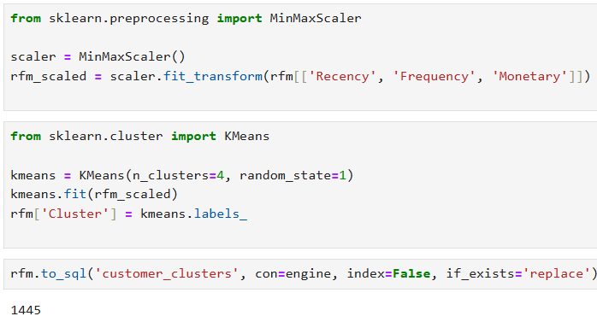
Customer Segmentation Using RFM Clustering
RFM Features: Used purchase history to calculate Recency, Frequency, and Monetary values
Data Normalization: Applied MinMaxScaler to scale RFM values for better clustering
KMeans Clustering: Grouped customers into 4 segments based on buying patterns
Results: Segmentation results stored in the customer_clusters table
Business Benefits
Understand customer behavior
Target high-value customers and re-engage inactive ones
Design custom campaigns for each segment

Slide 24

Power BI is a Business Intelligence tool from Microsoft that helps you analyze data, visualize insights and create interactive dashboards to support decision-making.

Slide 25
Data Model Relationships in Power BI

Slide 26
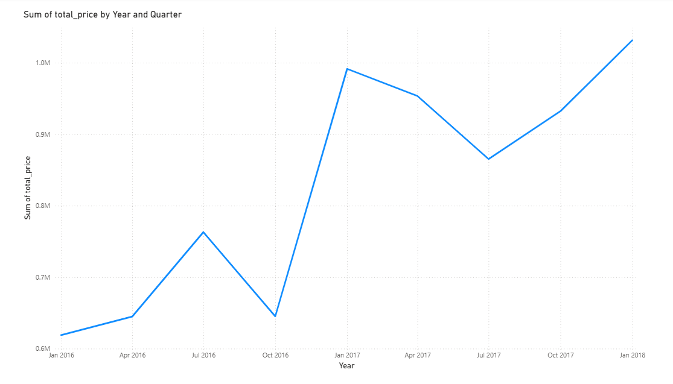

Slide 27
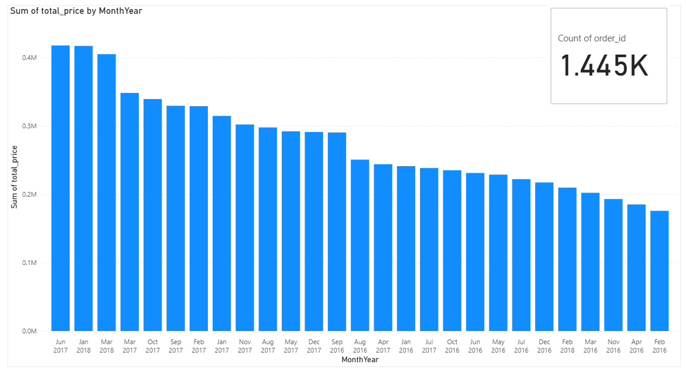

Slide 28
Sales Overview Visualizations
Used Power BI to visualize cleaned sales dataset.
Line Chart: Plotted Sum of Total_Price by Year & Quarter.
Bar Chart: Plotted Sum of Total_Price by MonthYear.
KPI Card: Calculated count of Order_IDs for total orders.
Benefits of These Visuals:
Line Chart helps in spotting long-term sales trends and seasonal growth.
Bar Chart gives clear view of monthly performance – useful for campaign planning.
Order KPI shows total engagement (order volume), useful for business forecasting.
Easy to identify high-performing months/quarters and sales drop periods.

Slide 29
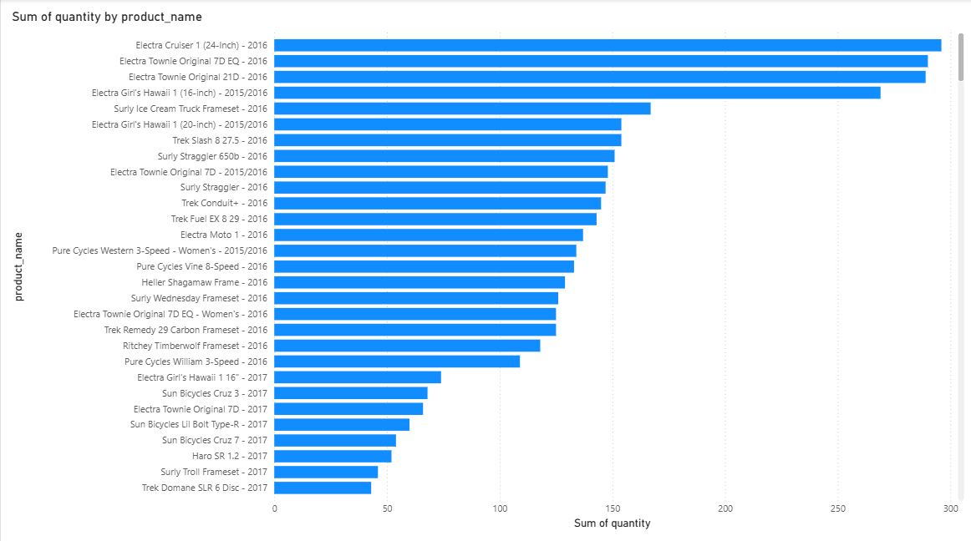
Top-Selling Products by Quantity

Slide 30
Top-Selling Products by Quantity
Collected sales data with fields: product_name and quantity.
Used Power BI to create a bar chart.
Dragged product_name to the Y-axis and Sum of quantity to the X-axis.
Sorted the chart in descending order to see which products sold the most.
Applied data labels for clear readability.
Benefits
Identifies best-selling products – Easy to see which products have high customer demand.
Helps with inventory planning – Stock can be prioritized for high-demand products.
Supports marketing strategy – Promotions can be focused on top-performing items.
Improves decision making – Managers can decide which products to push or retire.
Customer trend insight – Understand customer preferences based on purchase volume.

Slide 31
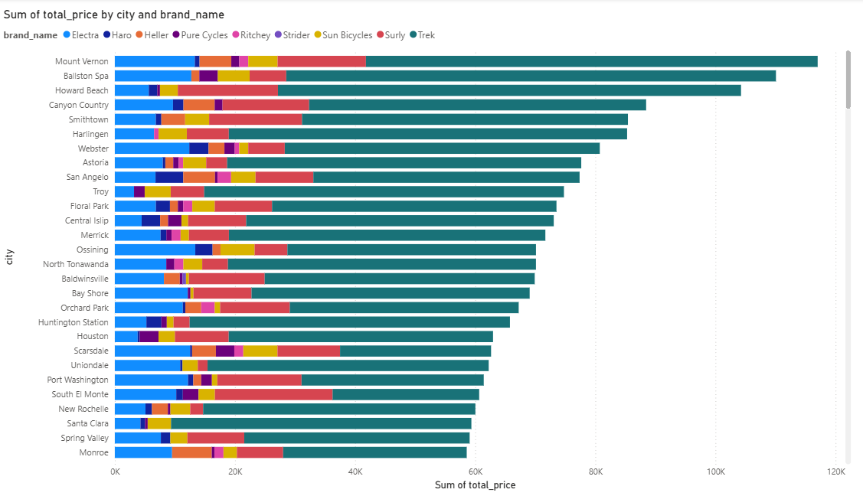
Customer Purchase Analysis by City and Brand

Slide 32
Customer Purchase Analysis by City and Brand
A stacked bar chart was created in Power BI to analyze customer purchase behavior across different cities.
Data used: customers, orders, order_items, and products tables.
The chart shows the sum of total_price by city and brand_name.
Different brands are color-coded within each bar, helping identify brand popularity in each region.
Benefits
Regional Demand Understanding: Helps determine which cities generate the most sales and for which brands.
Targeted Marketing: Enables location-wise brand promotions and personalized offers.
Inventory Optimization: Aligns stock levels based on brand demand by city, reducing overstock or stockouts.
Customer Behavior Insights: Understands brand preferences across locations, aiding in strategic planning.
Data-Driven Decisions: Provides a clear visual for stakeholders to decide on store expansion, bundling offers, or pricing strategies.

Slide 33
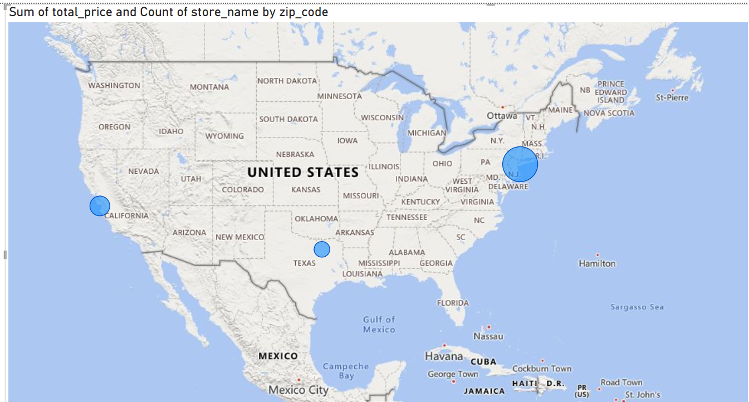
Sales by Store Map

Slide 34
Sales by Store Map
Used the Map visual in Power BI.
Dragged zip_code into the Location field.
Added Sum of total_price to Bubble Size to represent sales volume.
Included store_name in Tooltips to display store info on hover.
Applied formatting to enhance map readability.
Benefits
Geographical Insight: Shows where the highest sales are happening across locations.
Store Performance Tracking: Easily identify top-performing store regions.
Strategic Decision Support: Helps the business focus marketing or inventory efforts in high-performing areas.
Visual Clarity: Sales represented through bubble size makes it quick to compare different regions.
Location-based Trends: Detect regional trends and patterns that may not be obvious in tables.

Slide 35
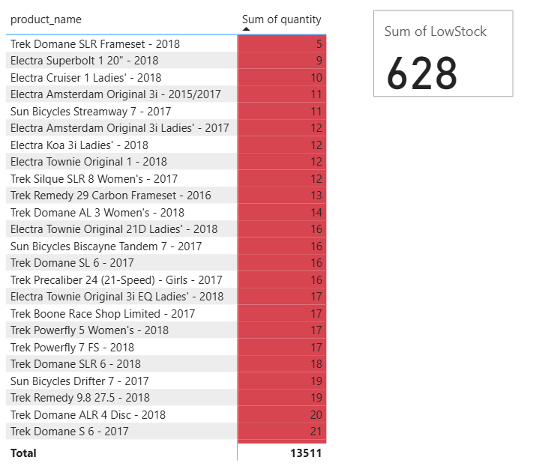
Low Stock Alert Dashboard
Created a Matrix table to display product names and their stock quantities.
Applied Conditional Formatting:
Highlighted products with stock quantity below 20 using a red background.
Created a Card visual to display the total number of units in low stock (Sum of LowStock).
Used DAX formulas to calculate:
Products below the threshold.
Total quantity of low-stock items.
Benefits
Quick Identification of low-stock products needing restocking.
Helps the inventory team make faster, data-driven decisions.
Prevents stockouts, improving customer satisfaction.
Saves time by visually highlighting critical items.
Ensures efficient inventory management and supply planning.

Slide 36
Staff Performance Report with Interactive Filters
Added slicers: Order Status, Store Name, Category Name
Created bar chart:
X-axis: Staff Full Name (first_name + last_name)
Y-axis: Sum of total_price
Linked necessary table relationships
Enabled dynamic filtering through slicers
Benefits
View top-performing staff by revenue
Analyze by store, category, or order status
Real-time insights for quick decisions
Ideal for performance reviews
User-friendly and interactive reporting

Slide 37
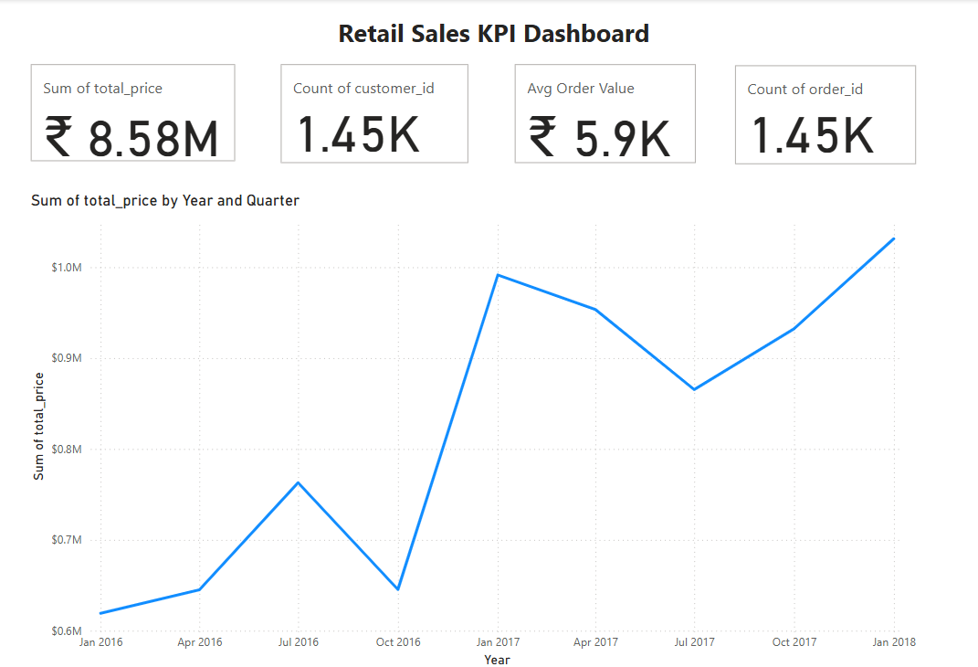

Slide 38

Retail Sales KPI Dashboard Summary
Created a Consolidated Dashboard in Power BI
Calculated key KPIs using DAX:
Total Revenue
Total Orders
Average Order Value
Active Customers
Designed a clean layout using 4 card visuals
Linked tables using data model relationships for accurate calculations
Benefits
Quick Business Overview – Key performance in one glance
Tracks Sales Trends – Understand order value and volume
Customer Insights – See how many are actively purchasing
Supports Data-Driven Decisions – Helps retail team focus on performance

Slide 39

Thanks!
Do you have any questions?
dineshgilli777@gmail.com
+91 9080345590

